Slide 1



ArcGIS Python API for GIS Analysts and Data Scientists
ROHIT SINGH rsingh@esri.com

Slide 2

This presentation uses a Jupyter Notebook
Download the notebook or browse it online at:
https://github.com/Esri/arcgis-python-api/blob/master/talks/uc2017

Slide 3


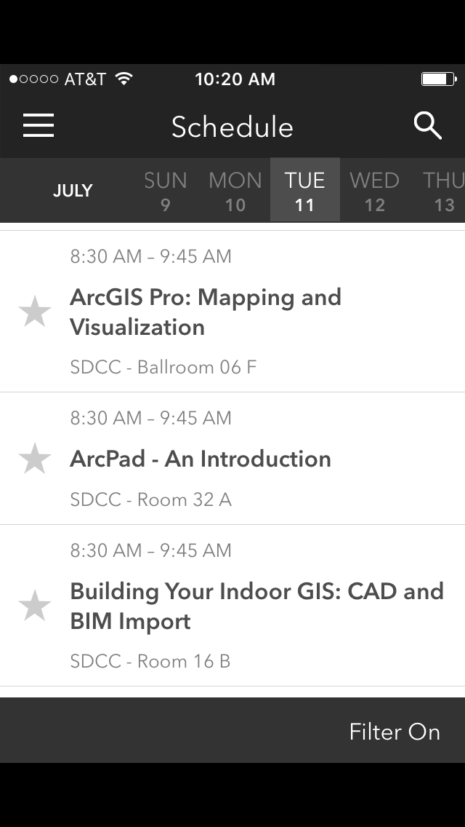
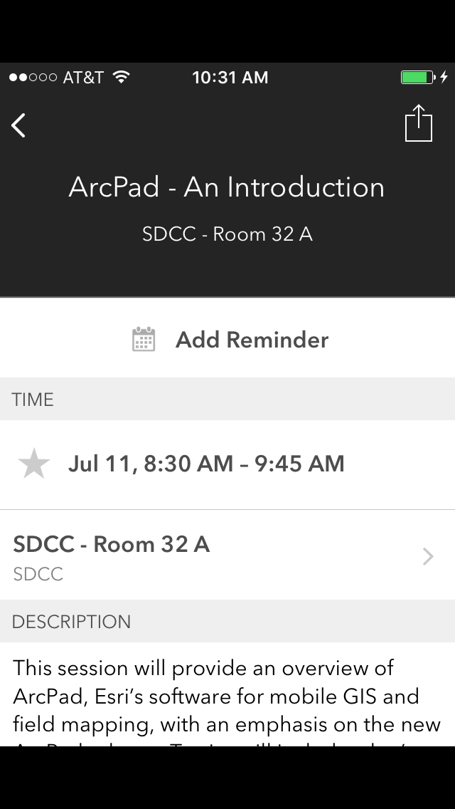
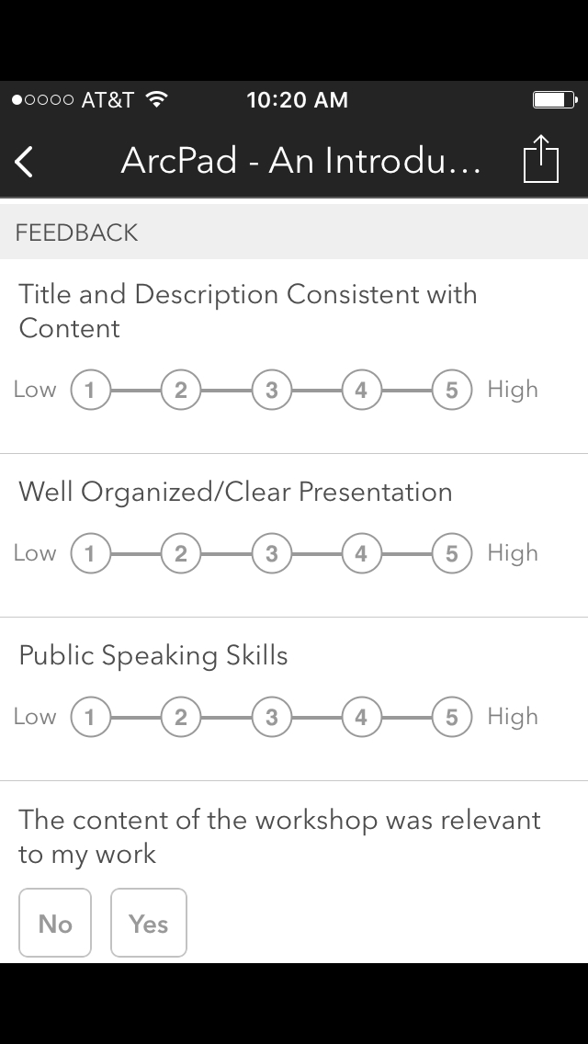

Please Take Our Survey on the Esri Events App!
Download the Esri Events app and find your event
Select the session you attended
Scroll down to find the survey
Complete Answers
and Select “Submit”

Slide 4



